Slide 1




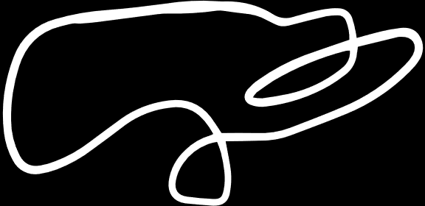
Supervised Machine Learning Techniques with R
Dr. Olga Korosteleva, CSULB
SoCal R Users Group Workshop
May 25, 2024

Slide 2



Outline
1. Decision Tree
6. $k$-Nearest Neighbor
2
2. Random Forest
7. Artificial Neural Network
3. Naïve Bayes
8. Change-point Detection
4. Gradient Boosting
9. Anomaly Detection
5. Support Vector Machine
10. Natural Language Processing
2

Slide 3
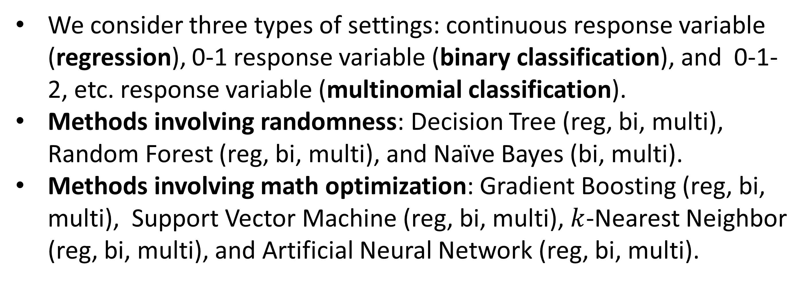
Big Picture
We consider three types of settings: continuous response variable (regression), 0-1 response variable (binary classification), and 0-1-2, etc. response variable (multinomial classification).
Methods involving randomness: Decision Tree (reg, bi, multi), Random Forest (reg, bi, multi), and Naïve Bayes (bi, multi).
Methods involving math optimization: Gradient Boosting (reg, bi, multi), Support Vector Machine (reg, bi, multi), $k$-Nearest Neighbor (reg, bi, multi), and Artificial Neural Network (reg, bi, multi).
2
3

Slide 4
A Big Picture
Methods for time-series data:
(involves randomness): change-point detection (continuous variable), and anomaly detection (continuous variable)
Method for texts: Natural Language Processing
2
4

Slide 5
1. Decision Tree
A decision tree is a type of flowchart that shows a clear pathway to a decision. It starts at a single point (or root node) which then branches (or splits) in two or more directions. Each branch offers different possible outcomes until a final outcome is achieved. When plotted as a graph, it resembles a tree. The nodes at the end of the decision path are called leaf nodes (or terminal nodes). Between the root node and the leaf nodes, there are internal nodes (or decision nodes).
5

Slide 6
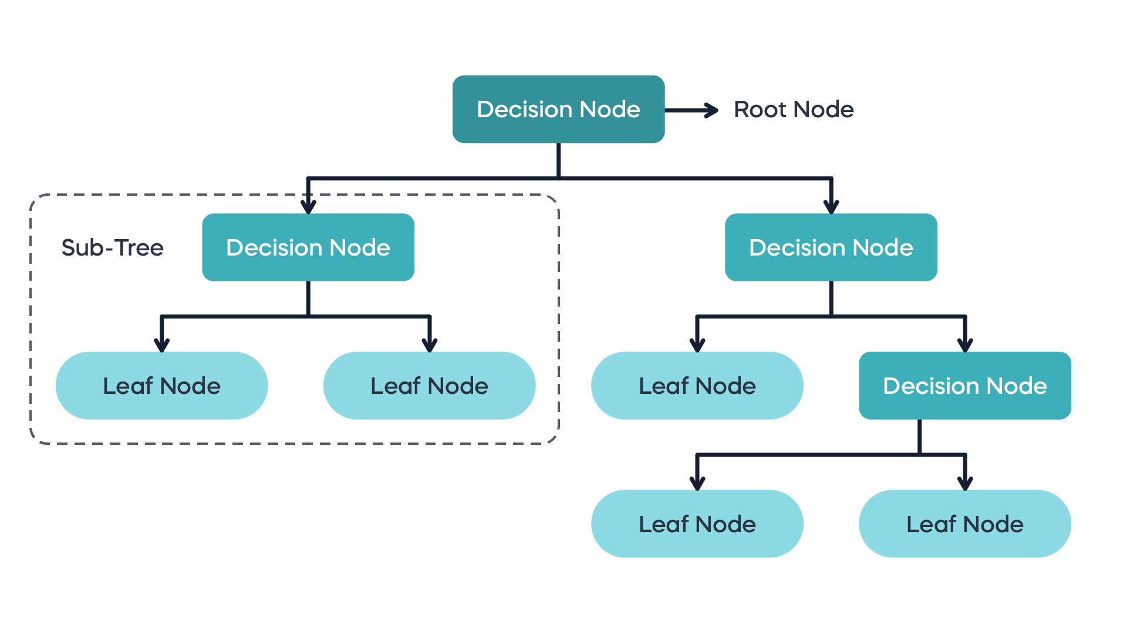
1. Decision Tree (cont.)
6

Slide 7
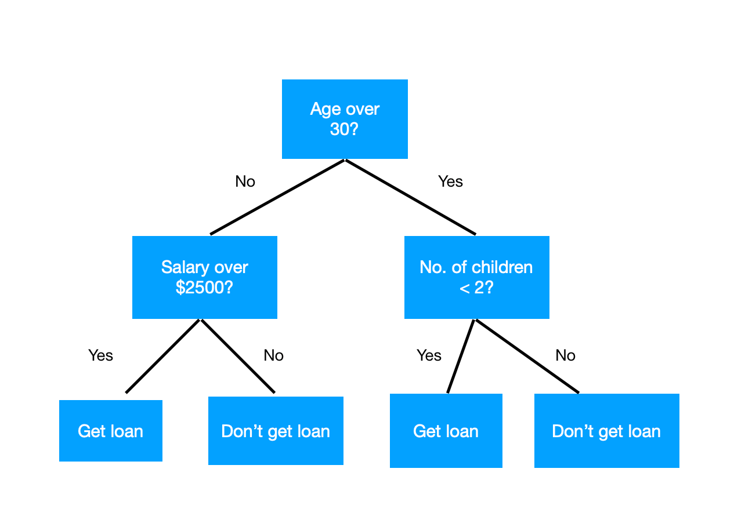
1. Decision Tree (cont.)
7

Slide 8
1. Decision Tree (cont.)
Decision trees work for regression, binomial classification, and multinomial classification.
The response variable is called the target variable and predictors are termed features.
A decision tree partitions the population into homogeneous non-overlapping sets, based on the most significant features.
If a full decision tree is too complex, pruning is applied, reducing the number of splits and terminal nodes.
8

Slide 9
1. Decision Tree (cont.)
When fitting a model, it is customary to split the original data set randomly into a training set (70% or 80% of the data rows) and a testing set (remaining 30% or 20% of the rows).
Then the model is developed on the training set and is used to predict values for the testing set.
The accuracy of prediction is computed as a measure of the goodness-of-fit of the model.
9

Slide 10
1. Decision Tree (cont.)
For the regression problem (continuous target variable), the prediction accuracy is the proportion of predicted values that lie within 10%, 15%, and 20% of the actual values.
For the classification problem (bi or milti), prediction is given as the probability of each class, so the class with the highest predicted probability is assumed to be the predicted class. The accuracy in this case is the proportion of classes predicted correctly.
10

Slide 11
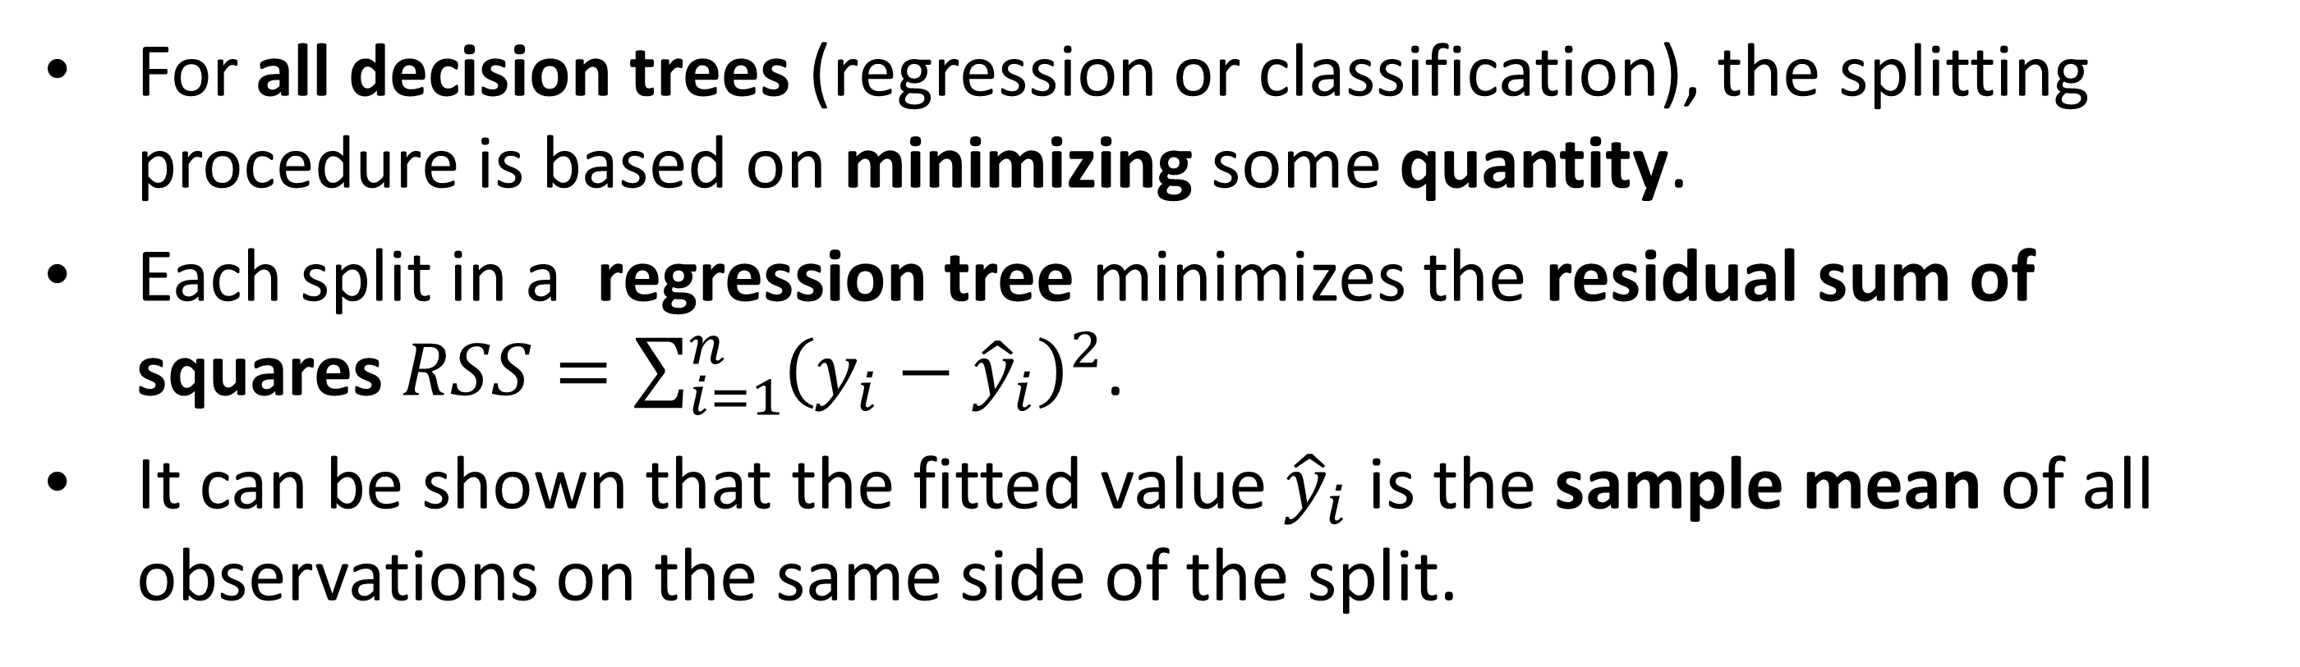
1. Decision Tree (cont.)
For all decision trees (regression or classification), the splitting procedure is based on minimizing some quantity.
Each split in a regression tree minimizes the residual sum of squares $RSS=\sum_{i=1}^{n}{{\left(y_{i}−{\hat{y}}_{i}\right)}^{2}}$.
It can be shown that the fitted value ${\hat{y}}_{i}$ is the sample mean of all observations on the same side of the split.
11

Slide 12
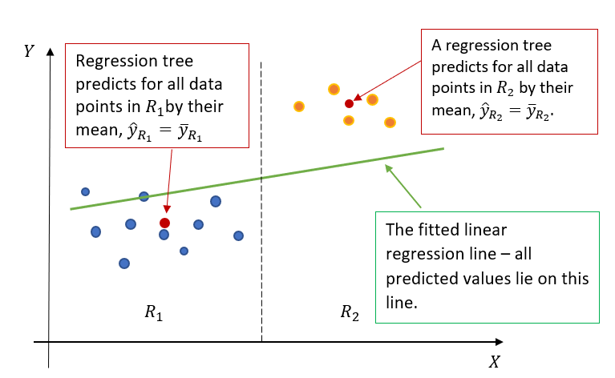
1. Decision Tree (cont.)
12

Slide 13
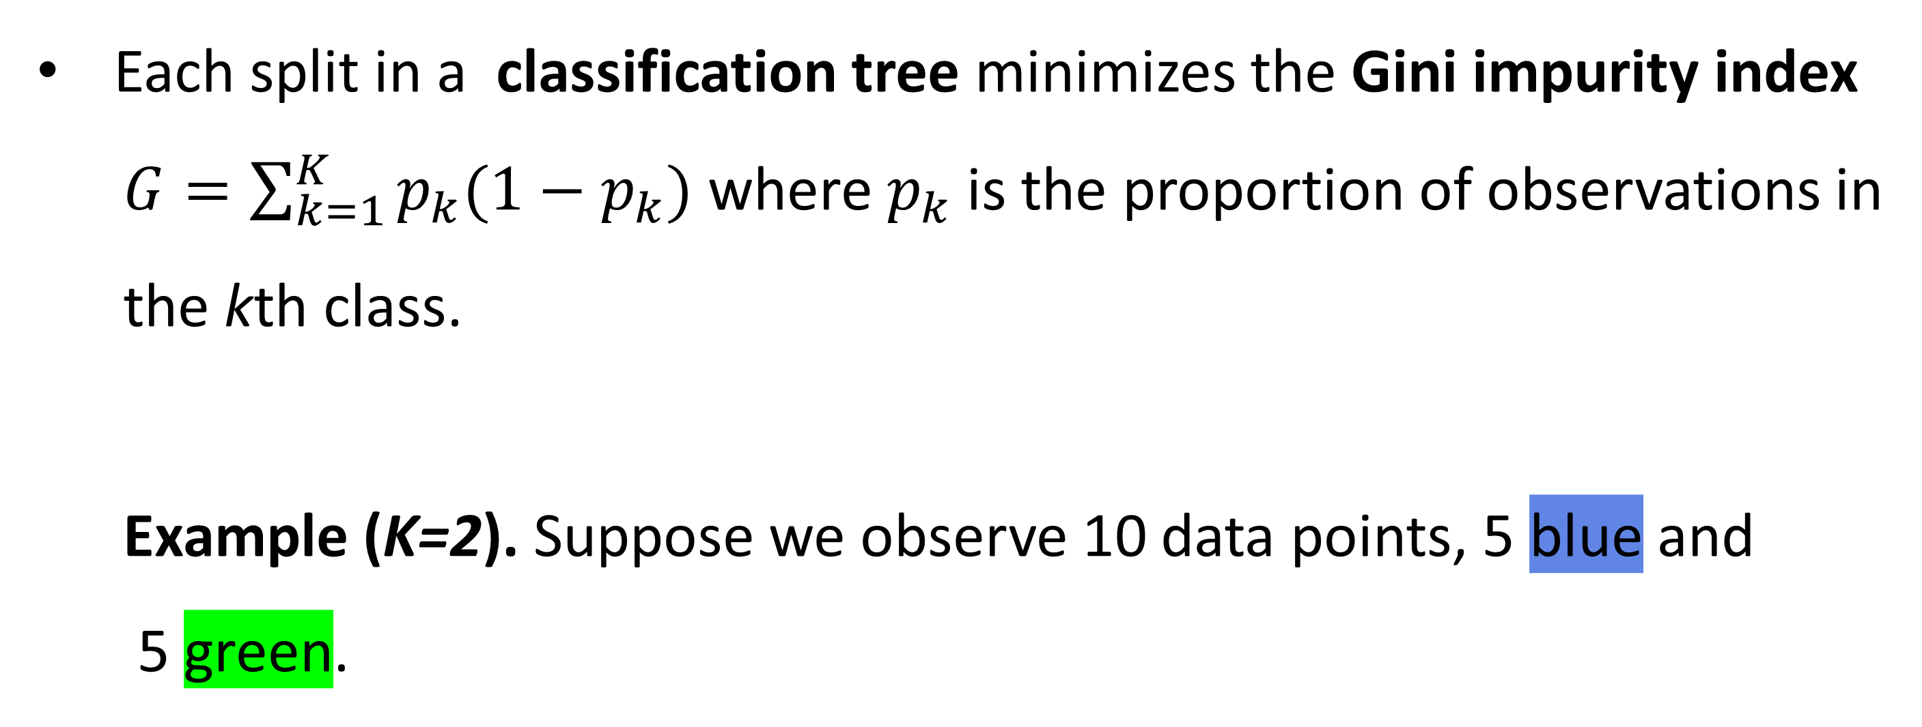
1. Decision Tree (cont.)
Each split in a classification tree minimizes the Gini impurity index
$G=\sum_{k=1}^{K}{p_{k}(1−p_{k})}$ where $p_{k}$is the proportion of observations in
the kth class.
Example (K=2). Suppose we observe 10 data points, 5 blue and
5 green.
13

Slide 14
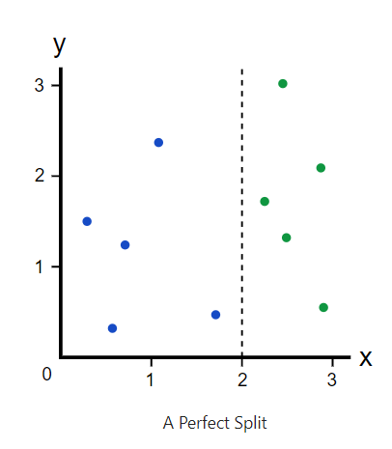
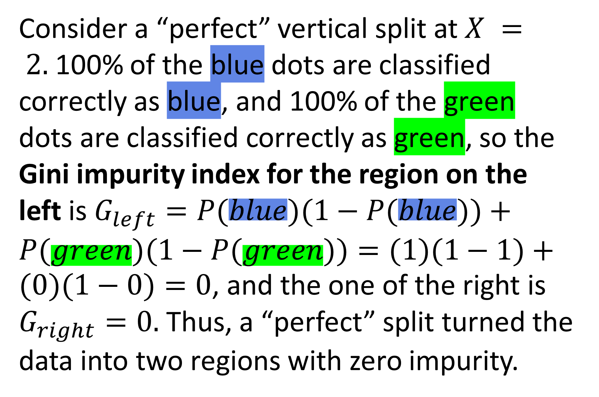
1. Decision Tree (cont.)
Consider a “perfect” vertical split at $X = 2.$100% of the blue dots are classified correctly as blue, and 100% of the green dots are classified correctly as green, so the Gini impurity index for the region on the left is $G_{left}=P(blue)(1−P(blue))+P(green)(1−P(green))=(1)(1−1)+(0)(1−0)=0$, and the one of the right is $G_{right}=0.$ Thus, a “perfect” split turned the data into two regions with zero impurity.
14

Slide 15
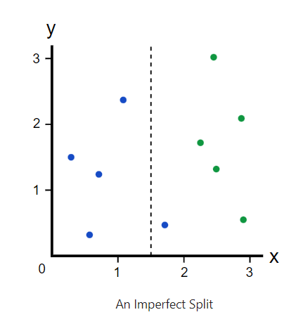
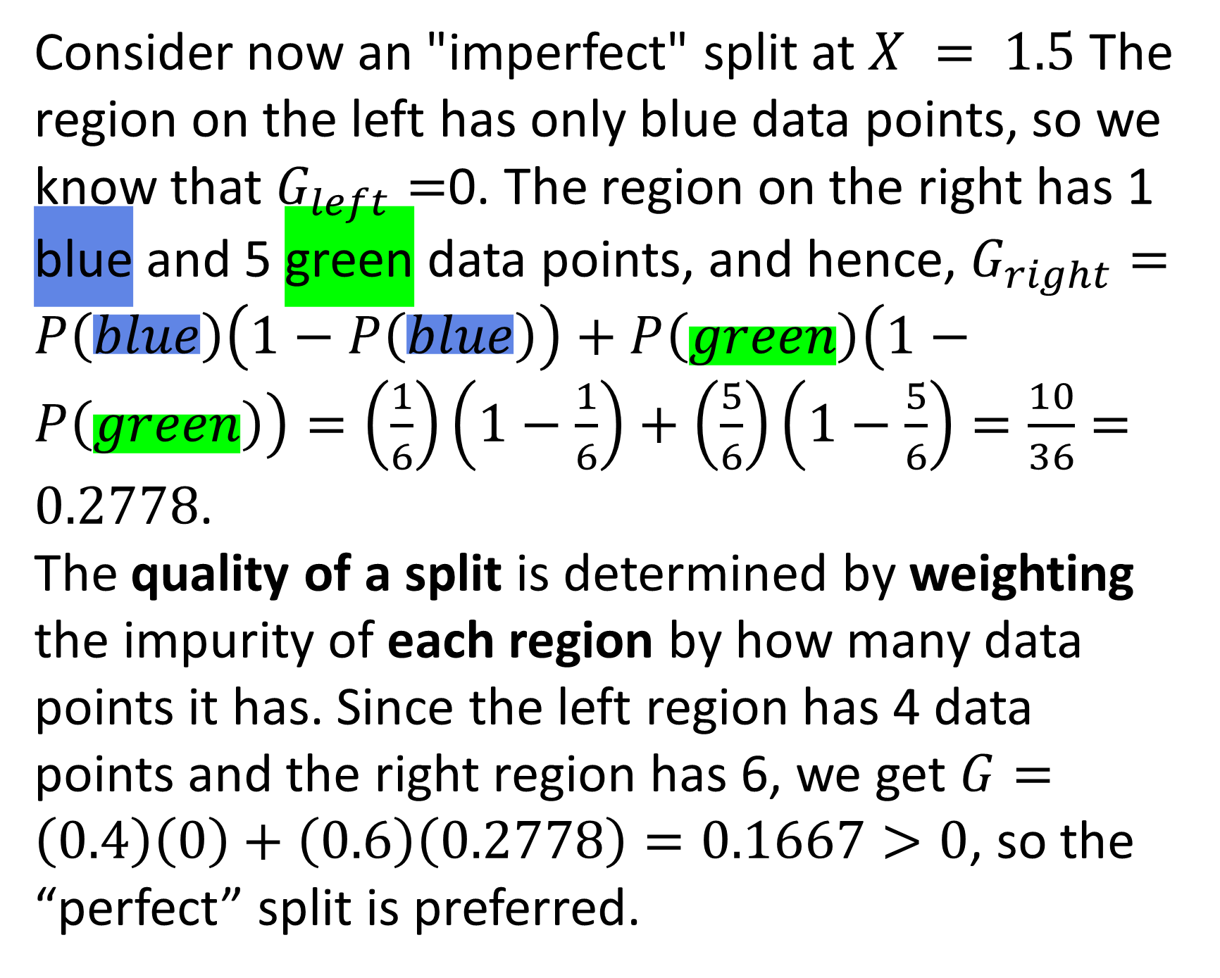
1. Decision Tree (cont.)
Consider now an "imperfect" split at $X = 1.5$ The region on the left has only blue data points, so we know that $G_{left}=$0. The region on the right has 1 blue and 5 green data points, and hence, $G_{right}=P\left(blue\right)\left(1−P\left(blue\right)\right)+P\left(green\right)\left(1−P\left(green\right)\right)=\left(\frac{1}{6}\right)\left(1−\frac{1}{6}\right)+\left(\frac{5}{6}\right)\left(1−\frac{5}{6}\right)=\frac{10}{36}=0.2778$.
The quality of a split is determined by weighting the impurity of each region by how many data points it has. Since the left region has 4 data points and the right region has 6, we get $G=\left(0.4\right)\left(0\right)+\left(0.6\right)\left(0.2778\right)=0.1667>0$, so the “perfect” split is preferred.
15

Slide 16
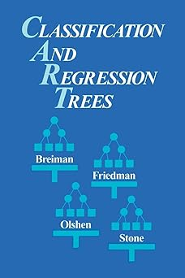
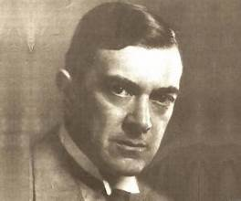
1. Decision Tree (cont.)
Historical Note.
The decision tree algorithm was introduced in the
book “Classification and Regression Trees” by
Breiman, L., Friedman, J., Olshen, R., and C. Stone,
Chapman and Hall, Wadsworth, New York, 1984.
The Gini impurity index is named after an Italian
statistician Corrado Gini (1884-1965) who proposed
the idea in his 1912 book published in Italian under the
name of “Variabilità e Mutabilità” (“Variability and Mutability”).
16

Slide 17


1. Decision Tree – Coding Examples
Regression Tree – Housing Data
Binary Classification Tree – Pneumonia Data
Multinomial Classification Tree – Movie Data
17

Slide 18
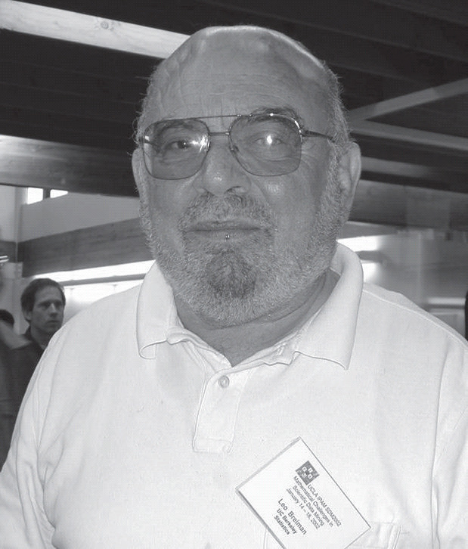
2. Random Forest
Decision trees are prone to bias and overfitting.
A more practical approach is to construct multiple decision trees and combine the results into a single output. This approach is termed the ensemble method.
The most well-known ensemble method is
bagging (bootstrap + aggregation). This method
was introduced in 1996 by Leo Breiman (1928-2005).
18

Slide 19
2. Random Forest (cont.)
In the bagging method, data points in the training set are sampled with replacement (producing a bootstrap sample).
Decision trees are generated independently for each bootstrap sample.
The results are then aggregated. For regression trees, an average of predicted values is computed. For classification trees, the majority of the predictions define the predicted class.
The bagging method reduces variance and, as a result, yields more accurate predictions than individual decision trees.
19

Slide 20
2. Random Forest (cont.)
The random forest algorithm is an extension of the bagging method as it utilizes both bagging and feature randomness.
Feature randomness generates a random subset of features. This ensures a low correlation among generated decision trees.
The results are then aggregated into a single prediction.
The random forest algorithm has three main hyperparameters: the number of nodes, the number of trees, and the number of variables sampled.
20

Slide 21
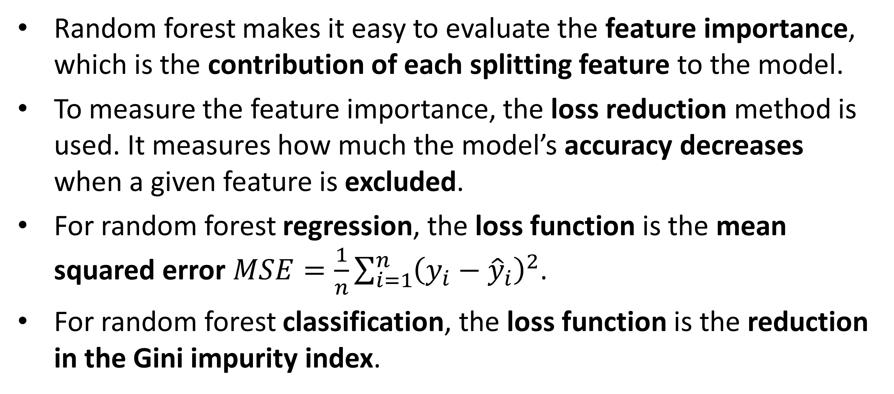
2. Random Forest (cont.)
Random forest makes it easy to evaluate the feature importance, which is the contribution of each splitting feature to the model.
To measure the feature importance, the loss reduction method is used. It measures how much the model’s accuracy decreases when a given feature is excluded.
For random forest regression, the loss function is the mean squared error $MSE=\frac{1}{n}\sum_{i=1}^{n}{{\left(y_{i}−{\hat{y}}_{i}\right)}^{2}}$.
For random forest classification, the loss function is the reduction in the Gini impurity index.
21

Slide 22
2. Random Forest – Coding Examples
Random Forest Regression – Housing Data
Random Forest Binary Classification – Pneumonia Data
Random Forest Multinomial Classification – Movie Data
22

Slide 23
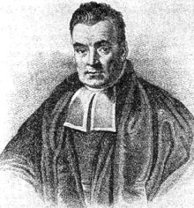
3. Naïve Bayes
Naïve Bayes classification is a method used for binary and multinomial classifications but not a regression.
The method utilizes the Bayes’ formula.
Historical Note.
Reverend Thomas Bayes (c. 1701 – 1761) was an
English statistician, philosopher, and Presbyterian
minister.
23

Slide 24
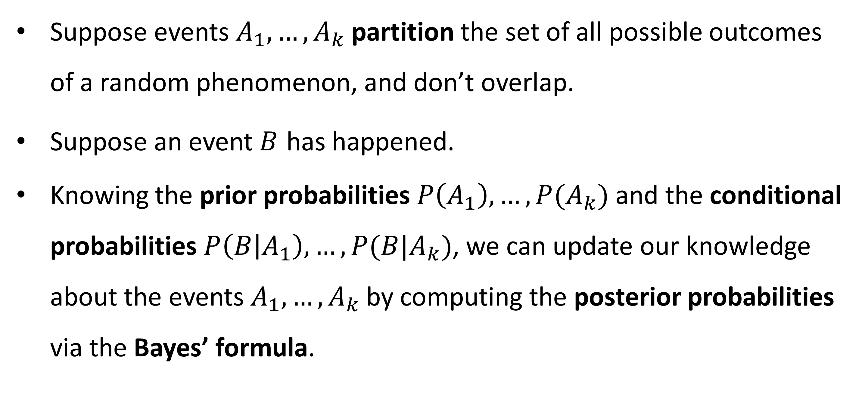
3. Naïve Bayes (cont.)
Suppose events $A_{1}, …, A_{k}$ partition the set of all possible outcomes of a random phenomenon, and don’t overlap.
Suppose an event $B$ has happened.
Knowing the prior probabilities $P\left(A_{1}\right), …, P(A_{k})$ and the conditional probabilities $P\left(B | A_{1}\right), …, P(B|A_{k})$, we can update our knowledge about the events $A_{1}, …, A_{k}$ by computing the posterior probabilities via the Bayes’ formula.
24

Slide 25
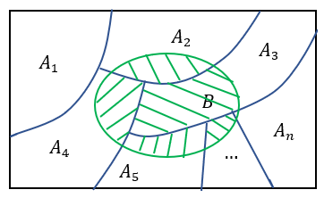
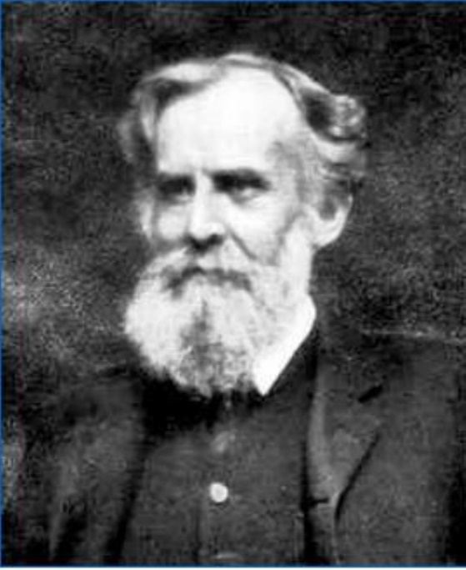
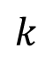
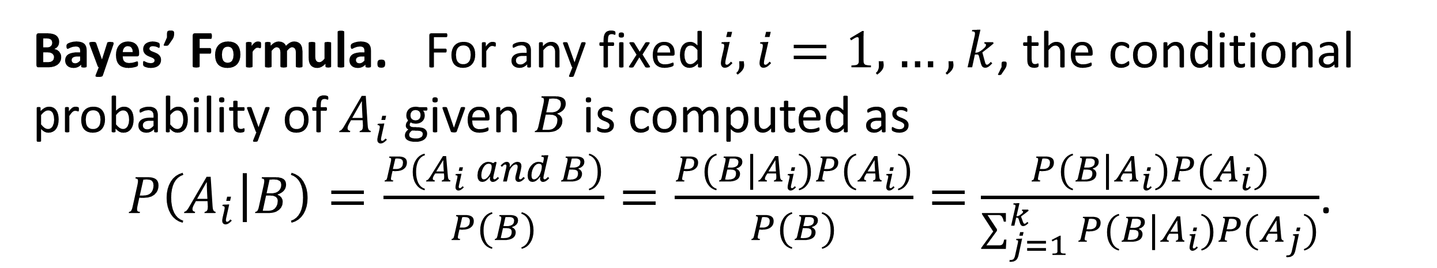
3. Naïve Bayes (cont.)
Historical Note. John Venn (1834 –1923) was
a British logician
and philosopher.
He introduced the
Venn diagram in 1880.
$$k$$
Bayes’ Formula. For any fixed $i, i=1,…, k$, the conditional probability of $A_{i}$ given $B$ is computed as
$P\left(A_{i} | B\right)=\frac{P(A_{i} and B)}{P(B)}=\frac{P(B|A_{i})P(A_{i})}{P(B)}=$ $\frac{P(B|A_{i})P(A_{i})}{\sum_{j=1}^{k}{P(B|A_{i})P(A_{j})}}$.
25

Slide 26
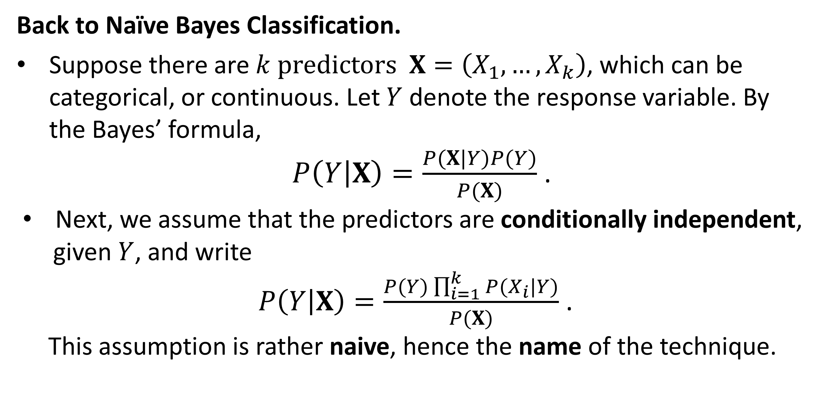
3. Naïve Bayes (cont.)
Back to Naïve Bayes Classification.
Suppose there are $k$predictors $X=\left(X_{1},…, X_{k}\right)$, which can be categorical, or continuous. Let $Y$ denote the response variable. By the Bayes’ formula,
$P\left(Y | X\right)=\frac{P(X|Y)P(Y)}{P(X)}$ .
Next, we assume that the predictors are conditionally independent,
given $Y$, and write
$P\left(Y | X\right)=\frac{P(Y)\prod_{i=1}^{k}{P(X_{i}|Y)}}{P(X)}$ .
This assumption is rather naive, hence the name of the technique.
26

Slide 27
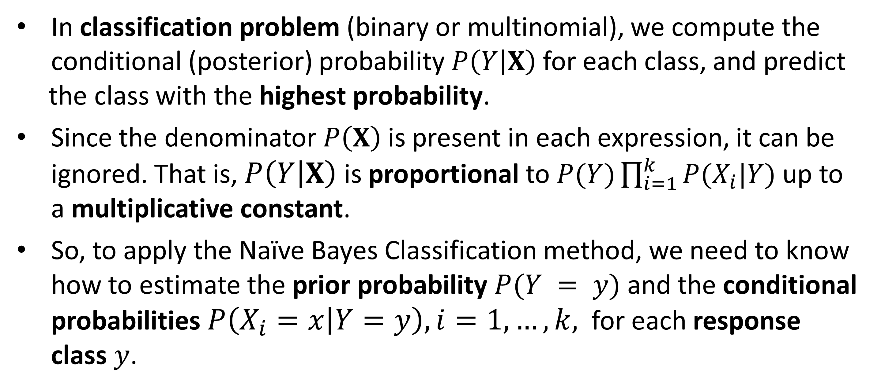
3. Naïve Bayes (cont.)
In classification problem (binary or multinomial), we compute the conditional (posterior) probability $P\left(Y | X\right)$ for each class, and predict
the class with the highest probability.
Since the denominator $P\left(X\right)$is present in each expression, it can be ignored. That is, $P\left(Y | X\right)$is proportional to $P(Y)\prod_{i=1}^{k}{P(X_{i}|Y)}$up to a multiplicative constant.
So, to apply the Naïve Bayes Classification method, we need to know how to estimate the prior probability $P(Y = y)$and the conditional probabilities $P\left(X_{i}=x | Y=y\right), i=1,…, k,$ for each response class $y$.
27

Slide 28
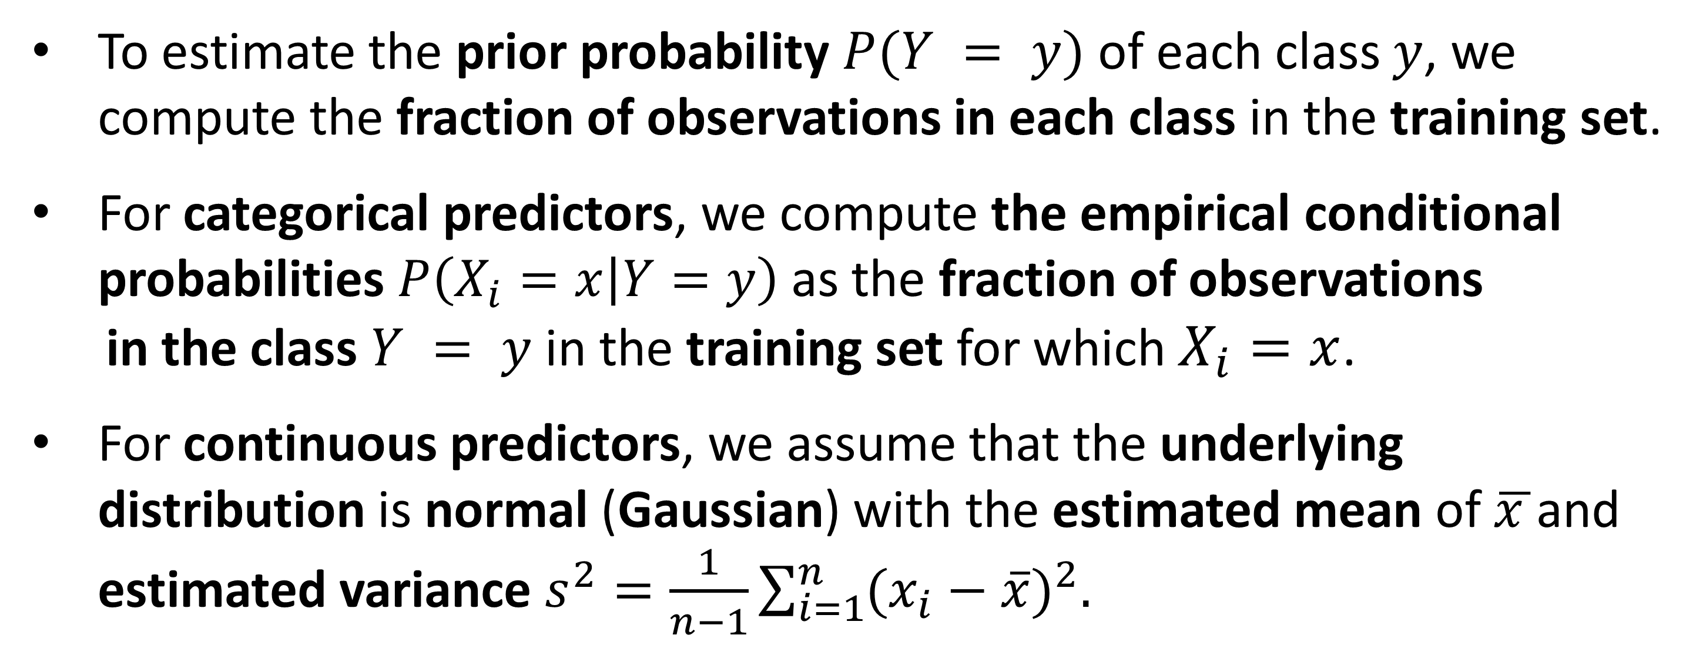
3. Naïve Bayes (cont.)
To estimate the prior probability $P(Y = y)$of each class $y$, we compute the fraction of observations in each class in the training set.
For categorical predictors, we compute the empirical conditional probabilities $P\left(X_{i}=x | Y=y\right)$ as the fraction of observations
in the class $Y = y$ in the training set for which $X_{i}=x$.
For continuous predictors, we assume that the underlying distribution is normal (Gaussian) with the estimated mean of $\overline{x }$and estimated variance $s^{2}=\frac{1}{n−1}\sum_{i=1}^{n}{{(x_{i}−\overline{x})}^{2}.}$
28

Slide 29
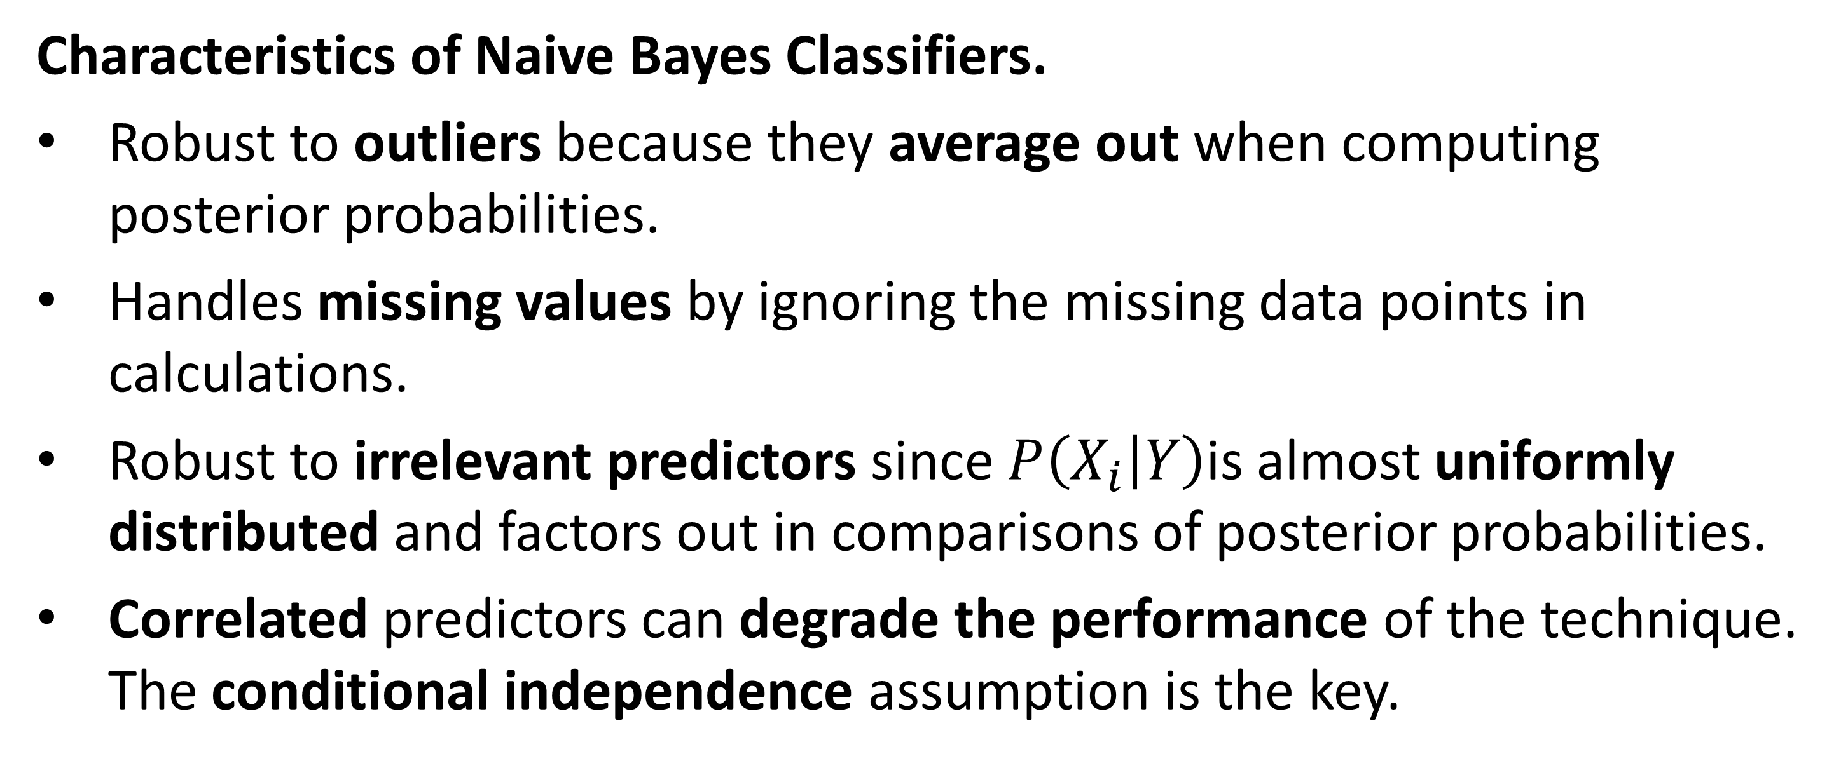
3. Naïve Bayes (cont.)
Characteristics of Naive Bayes Classifiers.
Robust to outliers because they average out when computing posterior probabilities.
Handles missing values by ignoring the missing data points in calculations.
Robust to irrelevant predictors since $P\left(X_{i} | Y\right)$is almost uniformly distributed and factors out in comparisons of posterior probabilities.
Correlated predictors can degrade the performance of the technique. The conditional independence assumption is the key.
29

Slide 30
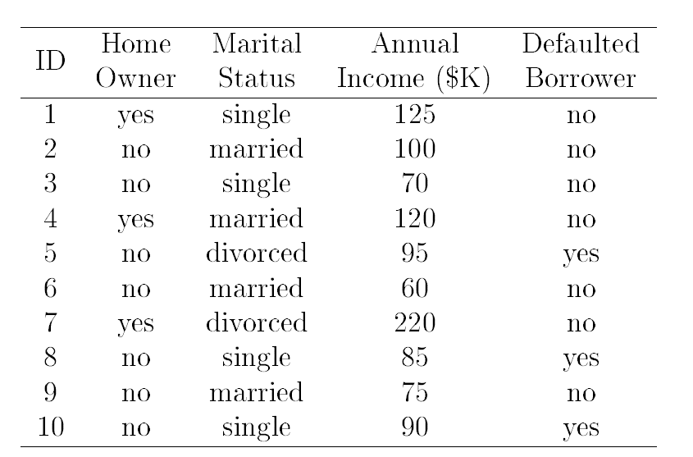
3. Naïve Bayes – Example
Suppose the training data are as given in the table below.
30

Slide 31
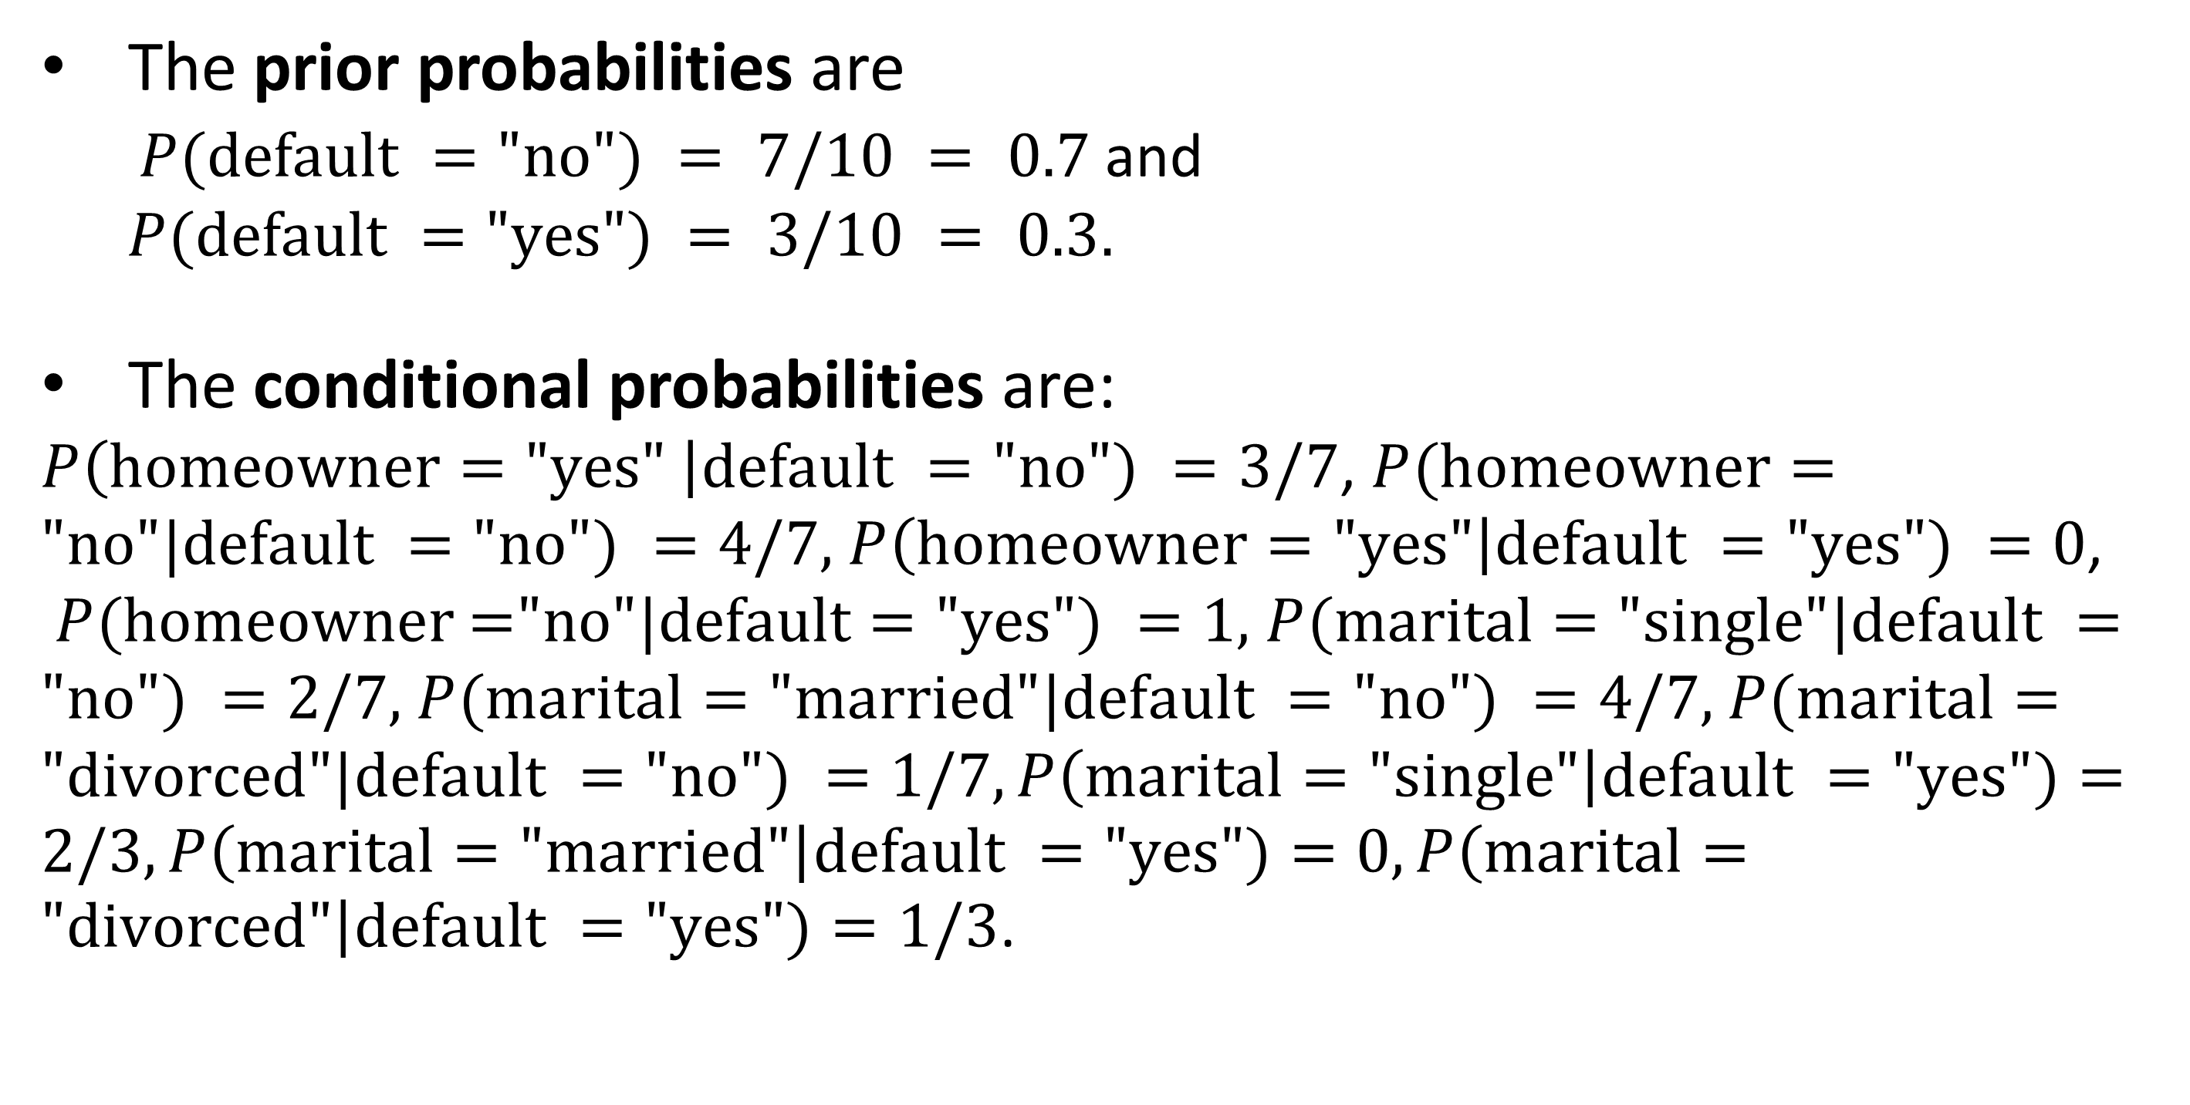
3. Naïve Bayes – Example (cont.)
The prior probabilities are
$P(default ="no") = 7/10 = 0.7$ and
$P(default ="yes") = 3/10 = 0.3.$
The conditional probabilities are:
$P\left(homeowner="yes" \right|default ="no") =3/7$, $P(homeowner=\text{"}no"|default ="no") =4/7,$ $P\left(homeowner="yes"\right|default ="yes") =0$, $P(homeowner\text{ =}"no"|default="yes") =1,$ $P(marital=\text{"}single"|default ="no") =2/7,$ $P(marital=\text{"}married"|default ="no") =4/7,$ $P(marital=\text{"}divorced"|default ="no") =1/7,P\left(marital="single"\right|default ="yes")=2/3, P\left(marital="married"\right|default ="yes")=0, P\left(marital="divorced"\right|default ="yes")=1/3$.
31

Slide 32
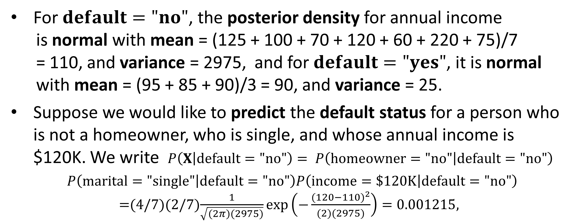
3. Naïve Bayes – Example (cont.)
For $default="no"$, the posterior density for annual income
is normal with mean = (125 + 100 + 70 + 120 + 60 + 220 + 75)/7
= 110, and variance = 2975, and for $default="yes"$, it is normal
with mean = (95 + 85 + 90)/3 = 90, and variance = 25.
Suppose we would like to predict the default status for a person who is not a homeowner, who is single, and whose annual income is $120K. We write $P\left(X | default=\text{"}\text{no}\text{"}\right)= P\left(homeowner=\text{"}\text{no}\text{"} | default=\text{"}\text{no}\text{"}\right)$
$P\left(marital=\text{"}\text{single}\text{"} | default=\text{"}\text{no}\text{"}\right)P\left(income=\$120K | default=\text{"}\text{no}\text{"}\right)$
$=$(4/7)(2/7)$\frac{1}{\sqrt{(2π)(2975)}}\exp\left(−\frac{{(120−110)}^{2}}{(2)(2975)}\right)=0.001215$,
32

Slide 33
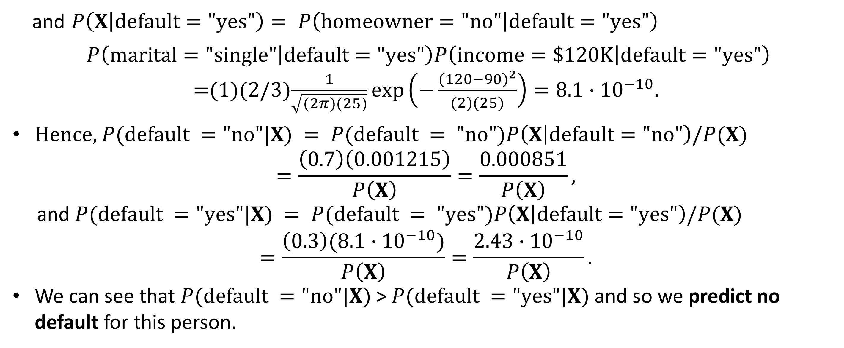
3. Naïve Bayes – Example (cont.)
and $P\left(X | default=\text{"}\text{yes}\text{"}\right)= P\left(homeowner=\text{"}\text{no}\text{"} | default=\text{"}\text{yes}\text{"}\right)$
$P\left(marital=\text{"}\text{single}\text{"} | default=\text{"}\text{yes}\text{"}\right)P\left(income=\$120K | default=\text{"}\text{yes}\text{"}\right)$
$=$(1)(2/3)$\frac{1}{\sqrt{(2π)(25)}}\exp\left(−\frac{{(120−90)}^{2}}{(2)(25)}\right)=8.1∙{10}^{−10}.$
Hence, $P(default ="no"|X) = P(default = "no")P\left(X | default=\text{"}\text{no}\text{"}\right)/P(X)$
$$=\frac{\left(0.7\right)\left(0.001215\right)}{P\left(X\right)}=\frac{0.000851}{P\left(X\right)},$$
and $P(default ="yes"|X) = P(default = "yes")P\left(X | default=\text{"}\text{yes}\text{"}\right)/P(X)$
$$=\frac{\left(0.3\right)(8.1∙{10}^{−10})}{P\left(X\right)}=\frac{2.43∙{10}^{−10}}{P\left(X\right)}.$$
We can see that $P(default ="no"|X)$> $P(default ="yes"|X)$and so we predict no default for this person.
33

Slide 34
3. Naïve Bayes – Coding Examples
Naïve Bayes Binary Classification – Pneumonia Data
Naïve Bayes Multinomial Classification – Movie Data
34

Slide 35

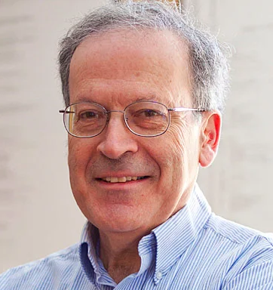
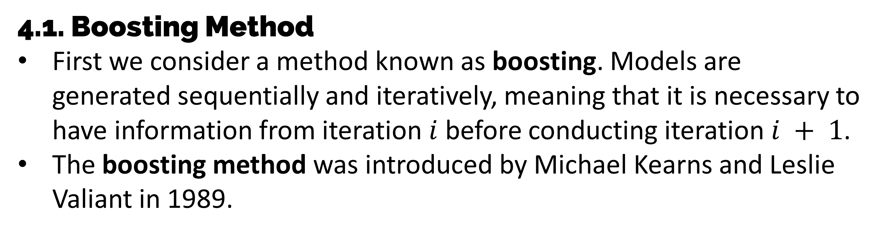
4. Gradient Boosting
4.1. Boosting Method
First we consider a method known as boosting. Models are generated sequentially and iteratively, meaning that it is necessary to have information from iteration $i$ before conducting iteration $i + 1$.
The boosting method was introduced by Michael Kearns and Leslie Valiant in 1989.
Dr. Michael Kearns, UPenn
Dr. Leslie Valiant, Harvard University
35

Slide 36
4.1. Boosting Method (cont.)
The question was whether it was possible to combine weak models (weak learners) to produce a single strong model (a strong learner).
Weak learners are only slightly better than chance at predicting a response. A strong learner is well-correlated with the response.
The idea of the boosting method is to build iteratively weak machine learning models on a continually updated response variable in the training data set and then add them together to produce a final strong learning model.
36

Slide 37
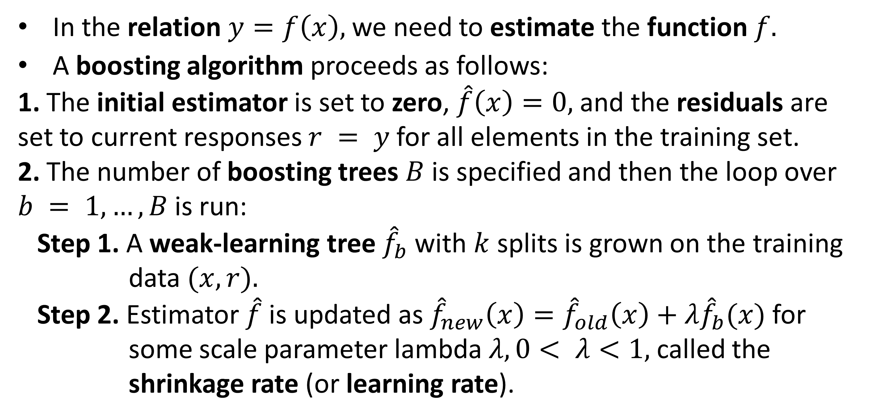
4.1. Boosting Method (cont.)
In the relation $y=f\left(x\right),$ we need to estimate the function $f.$
A boosting algorithm proceeds as follows:
1. The initial estimator is set to zero, $\hat{f}\left(x\right)=0,$and the residuals are set to current responses $r = y$ for all elements in the training set.
2. The number of boosting trees $B$ is specified and then the loop over
$b = 1, …, B$is run:
Step 1. A weak-learning tree ${\hat{f}}_{b}$with $k$ splits is grown on the training
data $(x, r).$
Step 2. Estimator $\hat{f}$is updated as ${\hat{f}}_{new}\left(x\right)={\hat{f}}_{old}\left(x\right)+λ{\hat{f}}_{b}(x)$ for
some scale parameter lambda $λ, 0< λ<1,$called the
shrinkage rate (or learning rate).
37

Slide 38
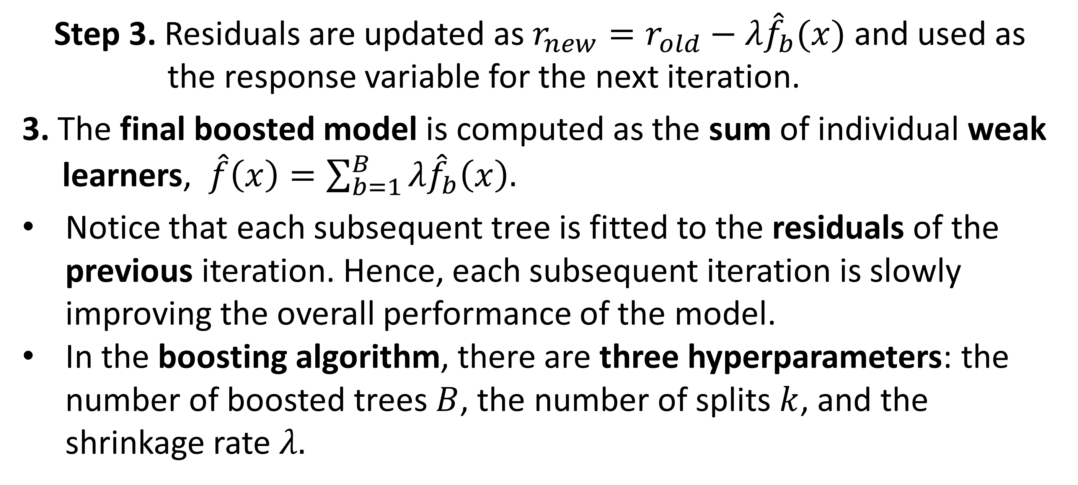
4.1. Boosting Method (cont.)
Step 3. Residuals are updated as $r_{new}=r_{old}−λ{\hat{f}}_{b}(x)$ and used as
the response variable for the next iteration.
3. The final boosted model is computed as the sum of individual weak
learners, $\hat{f}\left(x\right)=\sum_{b=1}^{B}{λ{\hat{f}}_{b}\left(x\right).}$
Notice that each subsequent tree is fitted to the residuals of the previous iteration. Hence, each subsequent iteration is slowly improving the overall performance of the model.
In the boosting algorithm, there are three hyperparameters: the number of boosted trees $B$, the number of splits $k$, and the shrinkage rate $λ.$
38

Slide 39

4.2. Gradient Boosting Method
The gradient boosting method combines the method of gradient descent (or steepest descent) and the boosting algorithm.
It was first introduced by Jerome Friedman in 1999.
Dr. Jerome Friedman, Professor Emeritus, Stanford University
39

Slide 40
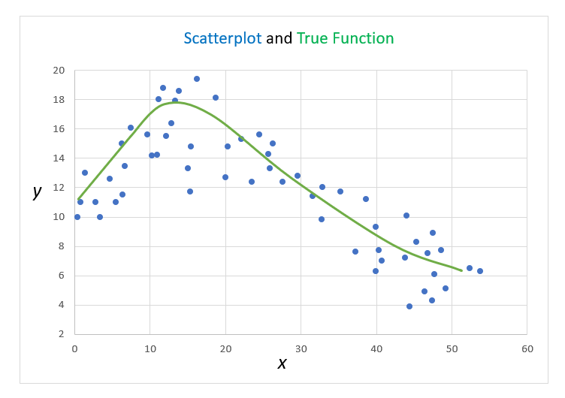
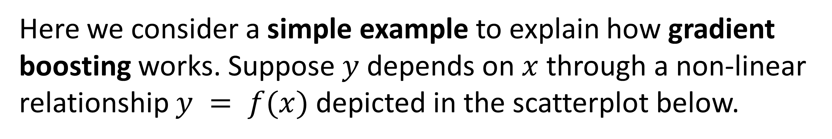
4.2. Gradient Boosting Method - Example
Here we consider a simple example to explain how gradient boosting works. Suppose $y$ depends on $x$ through a non-linear relationship $y = f(x)$depicted in the scatterplot below.
40

Slide 41
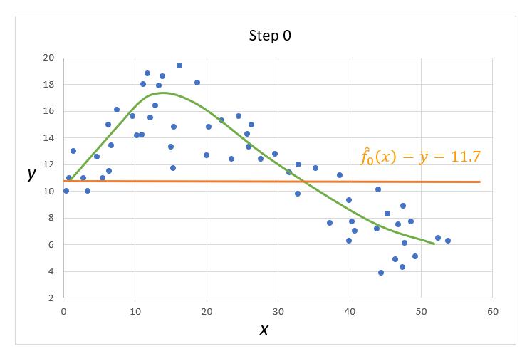
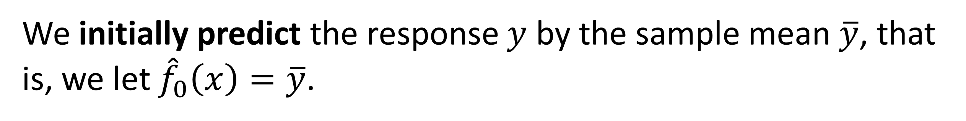
4.2. Gradient Boosting Method – Example (cont.)
We initially predict the response $y$ by the sample mean $\overline{y}$, that is, we let ${\hat{f}}_{0}\left(x\right)=\overline{y}$.
41

Slide 42
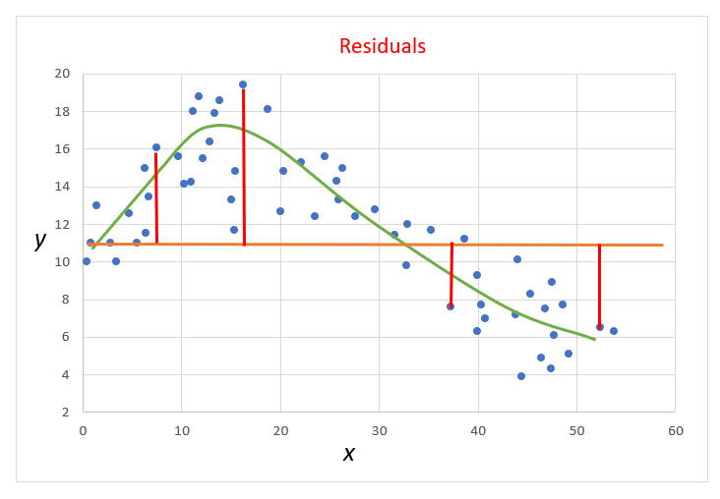
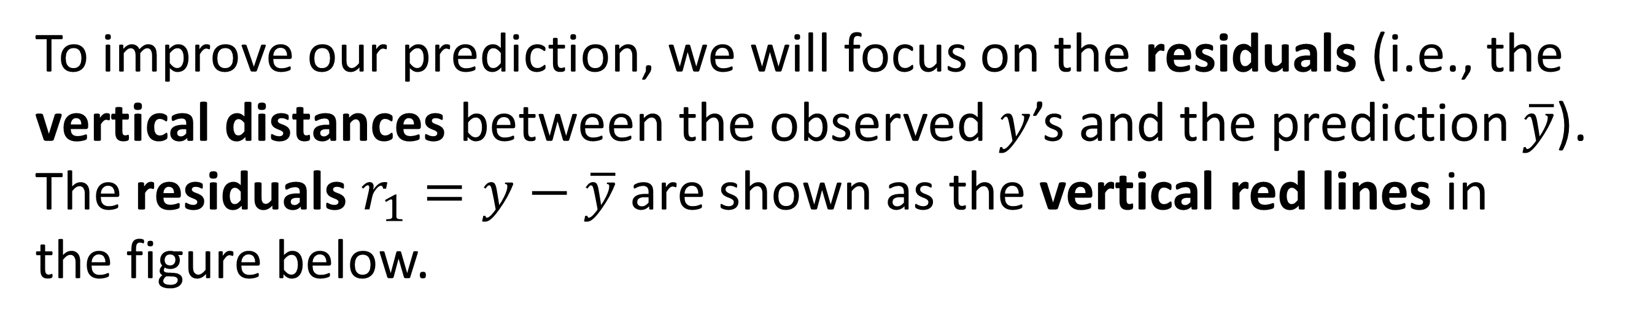
4.2. Gradient Boosting Method – Example (cont.)
To improve our prediction, we will focus on the residuals (i.e., the vertical distances between the observed $y$’s and the prediction $\overline{y}$). The residuals $r_{1}=y−\overline{y}$ are shown as the vertical red lines in
the figure below.
42

Slide 43
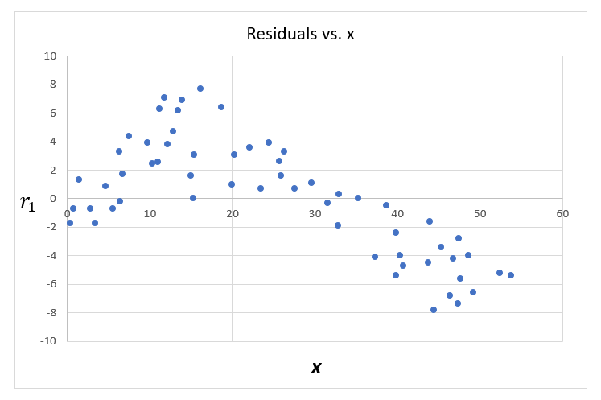
4.2. Gradient Boosting Method –Example (cont.)
Next, we plot the residuals against $x$.
43

Slide 44
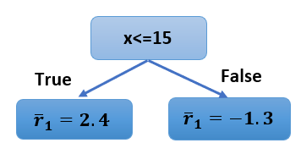
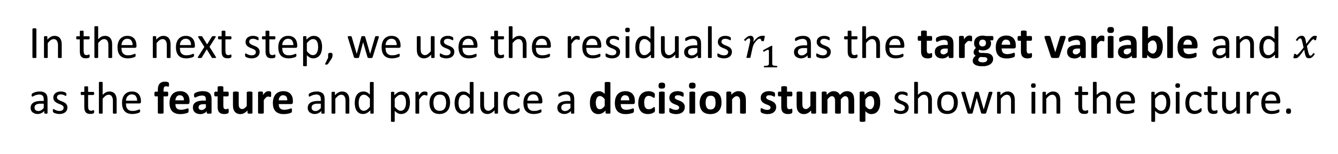
4.2. Gradient Boosting Method – Example (cont.)
In the next step, we use the residuals $r_{1}$ as the target variable and $x$ as the feature and produce a decision stump shown in the picture.
44

Slide 45
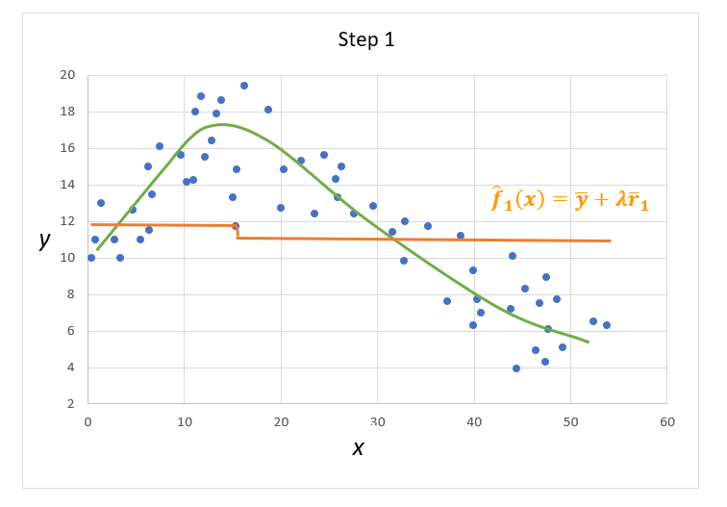
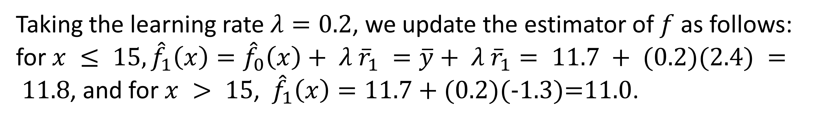
4.2. Gradient Boosting Method – Example (cont.)
Taking the learning rate $λ=0.2$, we update the estimator of $f$ as follows: for $x ≤ 15, {\hat{f}}_{1}\left(x\right)={\hat{f}}_{0}\left(x\right)+ λ {\overline{r}}_{1} =\overline{y}+ λ {\overline{r}}_{1}= 11.7 + (0.2)(2.4) = 11.8$, and for $x > 15$, ${\hat{f}}_{1}\left(x\right)=11.7+(0.\text{2)(-1.3)=11.0}$.
45

Slide 46
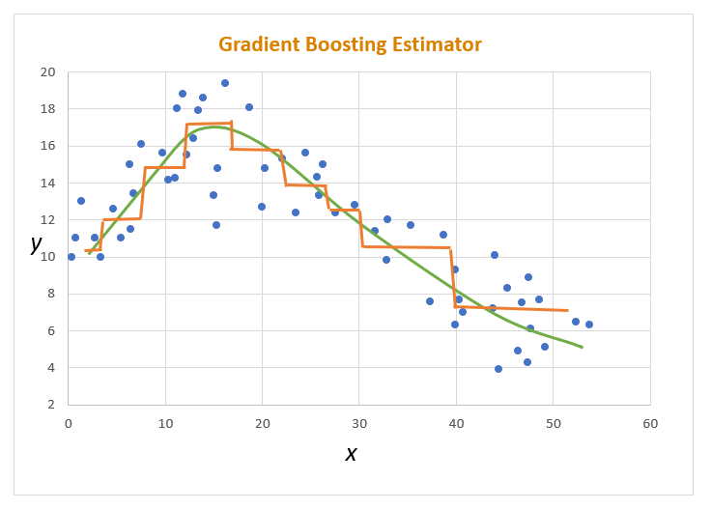
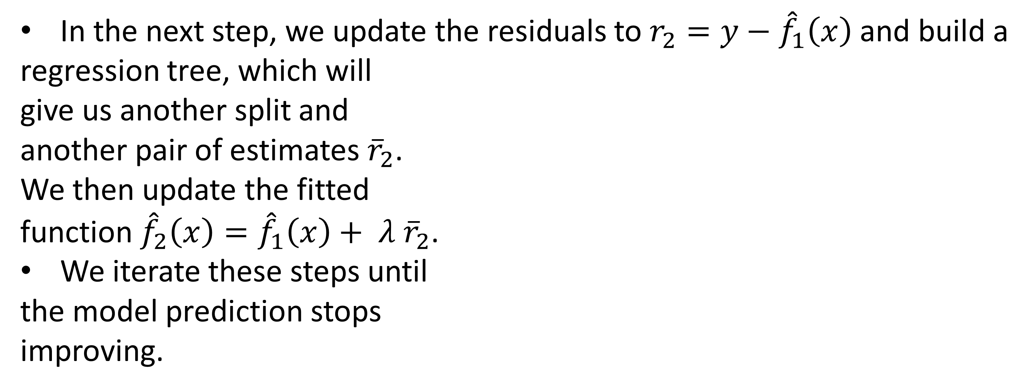
4.2. Gradient Boosting Method – Example (cont.)
In the next step, we update the residuals to $r_{2}=y−$ ${\hat{f}}_{1}\left(x\right)$and build a
regression tree, which will
give us another split and
another pair of estimates ${\overline{r}}_{2}$.
We then update the fitted
function ${\hat{f}}_{2}\left(x\right)={\hat{f}}_{1}\left(x\right)+ λ {\overline{r}}_{2}$.
We iterate these steps until
the model prediction stops
improving.
46

Slide 47
4.2. Gradient Boosting Method (cont.)
The method of gradient boosting is closely related to the method of gradient descent (or steepest descent), which is a first-order iterative optimization algorithm for finding a local minimum of a differentiable function.
The idea is to take repeated steps in the opposite direction of the gradient of the function at the current point because this is the direction of the steepest descent.
If the learning rate (length of step) is small, we would descend slowly along one slope.
However, we can choose to take large learning steps. The convergence is still guaranteed but it will take more time and computations to reach the minimum.
47

Slide 48
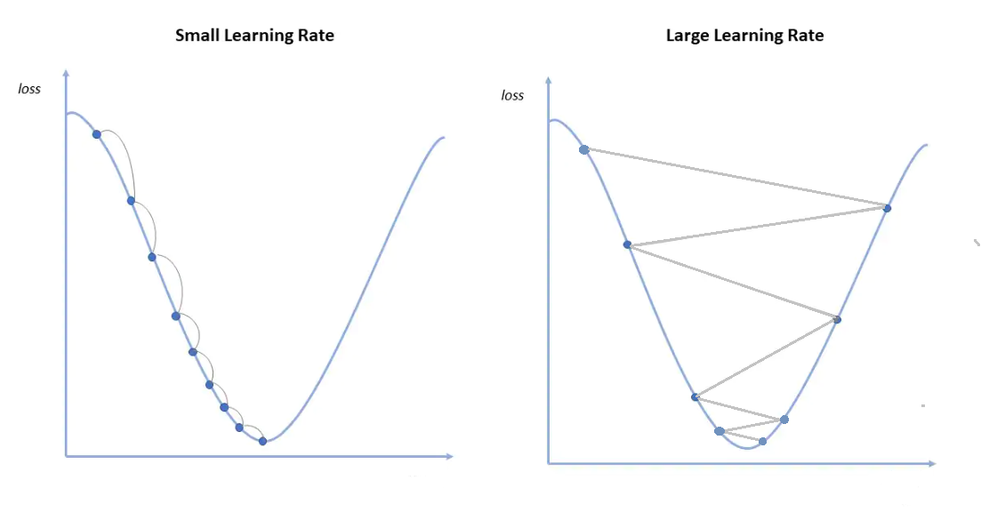
4.2. Gradient Boosting Method (cont.)
48

Slide 49
4.2. Gradient Boosting Method – Coding Examples
Gradient Boosting Regression – Housing Data
Gradient Boosting Binary Classification – Pneumonia Data
Gradient Boosting Multinomial Classification – Movie Data
49

Slide 50

5. Support Vector Machine
The Support Vector Machine (SVM) algorithm is a machine learning tool for regression and classification.
Historical Note.
An SVM method was first proposed by Vladimir Vapnik in his book "The Nature of Statistical Learning Theory", Springer-Verlag, New York, 1995.
50

Slide 51
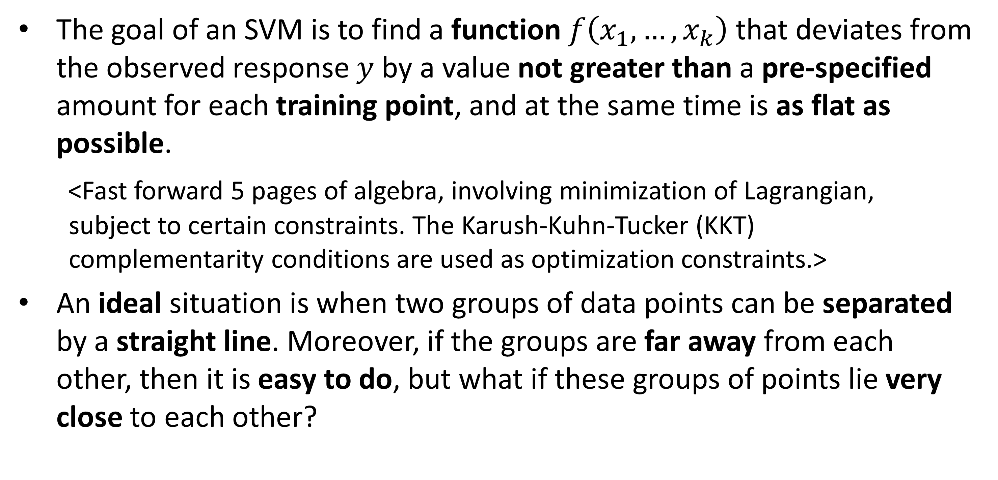
5. Support Vector Machine (cont.)
The goal of an SVM is to find a function $f\left(x_{1},…,x_{k}\right)$ that deviates from the observed response $y$ by a value not greater than a pre-specified amount for each training point, and at the same time is as flat as possible.
<Fast forward 5 pages of algebra, involving minimization of Lagrangian,
subject to certain constraints. The Karush-Kuhn-Tucker (KKT)
complementarity conditions are used as optimization constraints.>
An ideal situation is when two groups of data points can be separated by a straight line. Moreover, if the groups are far away from each other, then it is easy to do, but what if these groups of points lie very close to each other?
51

Slide 52
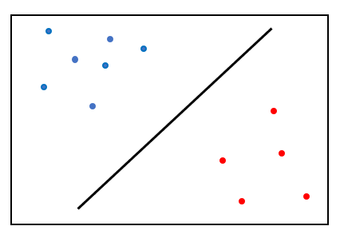
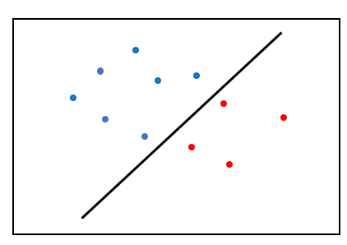
5. Support Vector Machine (cont.)
Groups of points are far away from each other – easy to separate with a linear function.
Groups of points are close together – harder to separate with a linear function.
52

Slide 53

5. Support Vector Machine (cont.)
Support Vectors are data points that lie the closest to the separating line. Hence, the name of the technique.
53

Slide 54

5. Support Vector Machine (cont.)
For some data sets, classes cannot be separated by a linear hyperplane of the form $\sum_{i=1}^{k}{w_{i}x_{i}}=a$ where $w_{1},…,w_{k}$ and$a$are some coefficients.
In those situations, a kernel trick technique is utilized. A kernel-based separating hyperplane may be chosen from the following three:
Polynomial: $\sum_{i=1}^{k}{w_{i}x_{i}^{d}}=a$ where $d>1,$
Radial Basis Function (RBF) (or Gaussian): $exp\left(−\sum_{i=1}^{k}{w_{i}x_{i}^{2}}\right)=a$,
or
Hyperbolic Tangent (or Sigmoid): $tanh\left(\sum_{i=1}^{k}{w_{i}x_{i}^{2}}\right)=a.$
tanh$\left(x\right)=\frac{\exp\left(x\right)−\exp\left(−x\right)}{\exp\left(x\right)+\exp\left(−x\right)}, −∞<x<∞.$
54

Slide 55

5. Support Vector Machine (cont.)
55

Slide 56

5. Support Vector Machine (cont.)
Note. Some points will be misclassified as they fall in the wrong group.
56

Slide 57
5. Support Vector Machine – Coding Examples
Support Vector Machine Regression – Housing Data
Support Vector Machine Binary Classification – Pneumonia Data
Support Vector Machine Multinomial Classification – Movie Data
57

Slide 58


6. $k$-Nearest Neighbor
“A man is known for the company he keeps.” - a proverb.
In the $k$ Nearest-Neighbor (kNN) algorithm, the space is divided into classes with $k$ nearest neighbors in each class.
The Euclidean distance is used to measure the distance between neighbors.
The Euclidean distance between two $d$-dimensional vectors
$x=(x_{1},…, x_{d})$ and y$=(y_{1},…, y_{d})$ in our regular Euclidean
geometry is defined as
$distance\left(x, y\right)=\sqrt{{\left(x_{1}−y_{1}\right)}^{2}+…+{\left(x_{d}−y_{d}\right)}^{2}}.$
58

Slide 59

6. $k$-Nearest Neighbor (cont.)
Historical Note.
The kNN algorithm was first described in “Discriminatory Analysis. Nonparametric Discrimination: Consistency Properties”, by Evelyn Fix and Joseph Hodges, Technical Report 4, USAF School of Aviation Medicine, Randolph Field, TX, 1951.
Later Thomas Cover and Peter Hart gave the statistical foundation for this method in “Nearest neighbor pattern classification”. IEEE Transactions on Information Theory, vol. IT-13, no. 1, pp. 21–27, 1967.
59

Slide 60

6. $k$-Nearest Neighbor (cont.)
For regression, the mean value of the class is used for prediction.
In classification, the class with the majority of observations is assigned as the predicted class.
For classification, it is wise to consider an odd number of neighbors to avoid ties.
60

Slide 61

6. $k$-Nearest Neighbor - Example
training set
testing set
61

Slide 62


6. $k$-Nearest Neighbor (cont.)
training set, $k=3$
This point is classified as blue because 2 out of its 3 nearest neighbors are blue.
BLUE
This point is classified as red because 2 out of its 3 nearest neighbors are red.
RED
In the testing set, one red point will be misclassified as blue.
62

Slide 63

5. Support Vector Machine – Coding Examples
$k$-Nearest Neighbor Regression – Housing Data
$k$-Nearest Neighbor Binary Classification – Pneumonia Data
$k$-Nearest Neighbor Multinomial Classification – Movie Data
63

Slide 64
7. Artificial Neural Network
An Artificial Neural Network (ANN) attempts to mimic the network of neurons that makes up a human brain so that computers will have the option to understand things and make decisions in a human-like manner.
An ANN consists of an input layer, hidden layers of nodes (or neurons, or perceptrons), and an output layer.
The input layer receives the raw input, which is then processed by multiple hidden layers, and the output layer produces the prediction.
Every neuron in the hidden layers is a linear combination of the input variables with some weights.
64

Slide 65

7. Artificial Neural Network (cont.)
An ANN with one hidden layer and a single neuron looks something like this:
65

Slide 66

7. Artificial Neural Network (cont.)
More generally, an ANN with multiple hidden layers would look something like this:
66

Slide 67

7. Artificial Neural Network (cont.)
A typical diagram of a biological neural network in the brain looks like this:
Dendrites from biological
neural networks represent
inputs in ANN, cell nucleus
represents nodes, synapse
represents weights, and
axon represents output.
67

Slide 68


7. Artificial Neural Network (cont.)
Historical Note.
The oldest type of neural network,
known as Perceptron, was introduced
by Frank Rosenblatt (1928-1971) in
1958.
Rosenblatt, F. (1958). ”The perceptron: A probabilistic model for information storage and organization in the brain.” Psychological Review, 65(6), 386–408.
68

Slide 69
7. Artificial Neural Network (cont.)
Theoretical Foundation.
In an ANN, the input goes through a series of transformations using the hidden layers, which finally result in the output expressed as a linear combination of weighted input features with a bias term included.
After producing the output, an error (or loss) is calculated and a
correction is sent back to the network. This process is known as
back (or backward) propagation.
Historical Note.
An ANN with back propagation was introduced in Rumelhart, D. E.,
Hinton, G. E., and Williams, R. J. (1986). “Learning representations
by back-propagating errors”. Nature, 323(6088), 533-536.
69

Slide 70

7. Artificial Neural Network (cont.)
An ANN starts with a set of initial weights and then gradually modifies the weights during the training cycle to settle down to a set of weights capable of realizing the input-output mapping with a minimum error.
Denote by $x_{i}=\left(x_{i1},…, x_{ik}\right)′, i=1,…,n,$ the set of vectors of input variables, and let $\hat{y}=({\hat{y}}_{1},…, {\hat{y}}_{n})′$ be the output vector. Also, suppose there is one hidden layer with $m$ neurons $h_{1},…, h_{m}$.
The response of the hidden layer for the ith individual is the vector
$h_{i}={\left(h_{i1}, …, h_{im}\right)}^{′}.$
70

Slide 71

7. Artificial Neural Network (cont.)
An ANN produces outputs governed by the relations:
$h_{i}=f\left(W_{h}x_{i}+b_{i}\right)$ and ${\hat{y}}_{i}=f\left(W_{i}^{∗}h_{i}+b_{i}^{∗}\right)$,
where $f$ is the activation function,$W_{h}=\left[\begin{matrix}w_{11} & ⋯ & w_{1k} \\ ⋮ & ⋱ & ⋮ \\ w_{m1} & ⋯ & w_{mk}\end{matrix}\right]$ is the
hidden layer weight matrix, $W_{i}^{∗}=\left(w_{i1}^{∗},…, w_{im}^{∗}\right)$ is the vector of
output weights for the ith individual, $b_{i}=(b_{i1}, …, b_{im})′$is the
hidden layer bias vector for the ith individual, and $b_{i}^{∗}$is the output
layer bias for the ith individual.
71

Slide 72


7. Artificial Neural Network (cont.)
The activation functions that can be employed in R are:
logistic (or sigmoid) $f\left(x\right)=\frac{\exp\left(x\right)}{1+\exp\left(x\right)} , −∞<x<∞,$
and
hyperbolic tangent (or tanh) $f\left(x\right)=\frac{\exp\left(x\right)−\exp\left(−x\right)}{\exp\left(x\right)+\exp\left(−x\right)}, −∞<x<∞.$
72

Slide 73

7. Artificial Neural Network (cont.)
The method of steepest descent is used to update the weights. They are updated according to the recursive relation
$$w_{ij}^{∗}\left(new\right)=w_{ij}^{∗}\left(old\right)− λ\frac{∂ L}{∂w_{ij}^{∗}\left(old\right)}, j=1,…, m,$$
where $λ$ represents the learning rate, and $L$ is the loss function.
The same algorithm applies to the weights in the hidden layers $W_{h}$.
73

Slide 74

7. Artificial Neural Network (cont.)
For an ANN regression, the loss function is the mean squared error
$$L=\frac{1}{n}\sum_{i=1}^{n}{{\left(y_{i}−{\hat{y}}_{i}\right)}^{2}}=\frac{1}{n}\sum_{i=1}^{n}{{\left(y_{i}−f\left(W_{i}^{∗}h_{i}+b_{i}^{∗}\right)\right)}^{2}}.$$
For an ANN classifiers, the loss function is the binary cross-entropy or multi-class cross-entropy defined as
$E=−\sum_{k=1}^{K}{p_{k}\ln\left(p_{k}\right)}$
where $p_{k}$is the proportion of observations in the kth class.
74

Slide 75
7. Artificial Neural Network – Coding Examples
ANN Regression – Housing Data
ANN Binary Classification – Pneumonia Data
ANN Multinomial Classification – Movie Data
75

Slide 76

8. Change-point Detection
Consider a time series data set consisting of $n$ normally distributed observations. And suppose that the first segment of $k$ observations has a $N(μ_{1}, σ^{2})$ distribution, whereas the remaining segment of $n−k$ observations has a $N(μ_{2}, σ^{2})$ distribution where $μ_{1} ≠μ_{2}$. That is, a change in mean occurs at some unknown step $k$.
The change-point detection is a collection of methods to identify the
value of $k$.
The change-point detection problem is also applicable to finding $k$ when the mean doesn’t change but the variance does, or when both mean and variance change.
76

Slide 77
8. Change-point Detection (cont.)
The change-point detection method also extends to the case of several segments with different means, variances, or both.
There are many well-developed methods to identify the point(s) of change. We will present the theory for the most basic approach.
The method of binary segmentation is often used to detect the change points. First, one change point is detected in the complete set of observations, then the series is split around this change point, and the algorithm is applied to the two resulting segments. The process continues until a pre-specified number of splits is detected.
77

Slide 78

8. Change-point Detection (cont.)
To identify the value of $k$ where the change occurs, the method of maximum likelihood estimation is employed.
We assume that $y_{1}, …, y_{k} \sim N\left(μ_{1},σ_{ }^{2}\right)$ and $y_{k+1}, …, y_{n} \sim N\left(μ_{2},σ_{ }^{2}\right).$
The maximum likelihood estimators of $μ_{1}$, $μ_{2},$and $σ_{ }^{2}$ are
$${\hat{μ}}_{1}={\overline{y}}_{1}=\frac{1}{k}\sum_{i=1}^{k}{y_{i}}, {\hat{μ}}_{2}={\overline{y}}_{2}=\frac{1}{n−k}\sum_{i=k+1}^{n}{y_{i}}, and {\hat{σ}}^{2}=\frac{1}{n−1}\sum_{i=1}^{n}{{\left(y_{i}−\frac{\sum_{j=1}^{n}{y_{j}}}{n}\right)}^{2}.}$$
78

Slide 79

8. Change-point Detection (cont.)
The likelihood function for these data has the form
$$L\left({\hat{μ}}_{1},{\hat{μ}}_{2},σ_{ }^{2} | y_{1}, …, y_{n}\right)={\left(2π{\hat{σ}}^{2}\right)}^{−n/2}\exp\left\{−\frac{\sum_{i=1}^{k}{{\left(y_{i}−{\overline{y}}_{1}\right)}^{2} + \sum_{i=k+1}^{n}{{\left(y_{i}−{\overline{y}}_{2}\right)}^{2}}}}{2{\hat{σ}}^{2}}\right\}.$$
The value of $k$ that maximizes the likelihood function is the optimal one. In practice, though, $k$ is chosen to minimize the Akaike Information Criterion $AIC=−2\ln{L} +2 p$ where $p$ is the number of parameters that have to be estimated from the data (in our example, we estimated ${\hat{μ}}_{1}, {\hat{μ}}_{2}$, and$,$ ${\hat{σ}}^{2}$, so $p=3$).
The term $2p$ is called a penalty term as it penalizes for introducing too many parameters into the model.
79

Slide 80
8. Change-point Detection (cont.)
Historical Note.
The pioneering work in the field of change-point detection is
the book “Detection of Abrupt Changes - Theory and Application”
by Michèle Basseville and Igor Nikiforov, Prentice-Hall, Inc., 1993.
The AIC criterion was introduced by Hirotugu Akaike (1927 –2009) in 1974 in his article “A new look at the statistical model identification”. IEEE Transactions on Automatic Control, 19 (6): 716 -723.
80

Slide 81
8. Change-point Detection – Coding Example
We apply the change-point detection methodology to daily closing Tesla stock prices between 6/30/2010 and 5/9/2024, a total of 3,489 observations. These historical data were downloaded from https://yahoofinance.com.
81

Slide 82

9. Anomaly Detection
Anomalies of a time series data can be defined as outliers of the remainders once the linear trend and seasonal periodicity are taken into account.
The outliers are determined as observations lying below $Q_{1}−3∙IQR$ or above $Q_{3}+3∙IQR$, where $Q_{1}$ is the first quartile (25th percentile), $Q_{3}$ is the third quartile (75th percentile), and the interquartile range is ${IQR=Q}_{3} {− Q}_{1}$.
More generally, in R, outliers are defined as values that lie $\frac{0.15}{α}∙IQR$ distance away from the quartiles. The default value of $α=0.05$, thus resulting in the multiplicative constant of 3.
82

Slide 83
9. Anomaly Detection – Coding Example
We apply the anomaly detection methodology to daily closing Tesla stock prices between 6/30/2010 and 5/9/2024.
83

Slide 84
10. Natural Language Processing
84

Slide 85


